Slide 1
Philosophers & Documents
Foundations of American Government

Slide 2
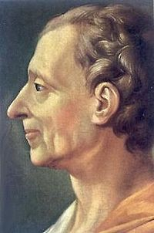
John Locke
Second Treatise on Government
Every man is created GOOD
Entitled to “Natural Rights” (life, liberty, and property)
Government is necessary
Representative Government= the best form of government
Separation of Powers= Good Idea

Slide 3
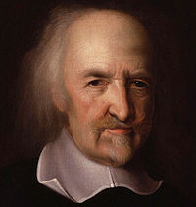
Thomas Hobbes
Leviathan
Every man is created EVIL
Need 1 single great POWER
Powerful people ABUSE power
No oligarchy or democracy
If leader is not doing what people want, get a new leader

Slide 4
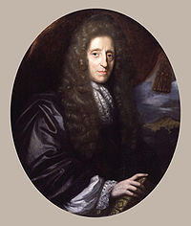
Charles Montesquieu
The Spirit Laws
3 types of government= monarchy, democracy, dictatorship
Government RULED BY THE PEOPLE= Best form of government
Separation of power- 3 branches- Legislative, Executive, Judicial
Checks and Balances

Slide 5
Common Theme
All 3 believed government and the state exists to serve the will of the people

Slide 6
Magna Carta
1215- nobles in England had enough of paying extra taxes
Barons rebelled and captured London
Met with the King to reach a peace agreement
King agreed to their demands by signing a document known as the Magna Carta- the “Great Charter”

Slide 7
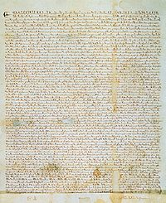
Magna Carta
Rights of people are protected against the power of the king or queen
Important Points:
The church had the final say in who was appointed to Church positions of power
The King was not allowed to demand more money from his nobility
Everyone has a right to a fair trial.

Slide 8
Petition of Right- 1628
King Charles I of England was unpopular with the people and parliament because he abused his power
He quartered troops in people's houses
He arrested people that went against him
He asked parliament for more money in taxes.

Slide 9
Petition of Right
Parliament made him agree to the following:
No troops could be quartered in people's houses
No taxes without Parliament's approval
No person can be jailed without reason

Slide 10
English Bill of Rights- 1688
Parliament gave control of England to William and Mary of Orange during the Glorious Revolution
Parliament worried the new monarchs would abuse their power like previous kings and queens
Made them sign a Bill of Rights

Slide 11
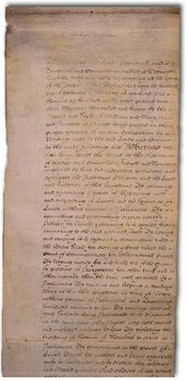
English Bill of Rights- 1688
The rules included:
Trial by jury
Due Process
No cruel punishment
No excessive fines or bails
Right to bear arms
Right to petition the government

Slide 12
Common Theme
All 3 documents limited the power of the government (aka “the kings and queens”)

