Slide 2
The President

Slide 3
The Executive Branch
Powers listed in Article II
Main duty: Enforce Laws
Includes:
The President
Vice-President
President’s Cabinet

Slide 4
Qualifications
To be the President or Vice President:
At least 35 years of age
Natural Born Citizen.
Resident for 14 years

Slide 5
Terms
22nd Amendment:
-Limits the President to two terms or 10 years

Slide 6
Salary
$400,000 per year
$50,000 a year allowance
Lives in the White House (132 rooms, 18.3 acres)
Air Force One
Plus other benefits

Slide 7
Powers & Limitations of the President
ROLE: CHIEF DIPLOMAT
1. general charge of foreign policy
2. appoints ambassadors
3. negotiates treaties

Slide 8
Powers & Limitations of the President
ROLE: COMMANDER IN CHIEF
1. civilian authority over the military (1.4 million)
A. War Powers Resolution 1973 (what is this?)
B. Congress declares war

Slide 9
Powers & Limitations of the President
ROLE: CHIEF LEGISLATOR
1. Veto/Sign Bills to law
- 2/3- both houses of Congress can override a veto

Slide 10
Powers & Limitations of the President
ROLE: HEAD OF POLITICAL PARTY
A. Face of the party
B. Party tied to success or failure of the President

Slide 11
Powers & Limitations of the President
ROLE: CHIEF CITIZEN
“the Representative of all the people”
Certain moral obligations

Slide 12
The Federal Bureaucracy
All of the agencies, people, and procedures that make the Federal Government operates.
The Constitution makes the President the Chief Administrator.
Constitution is relatively silent on the organization of the Executive Branch.

Slide 13
Executive Office of the President
Established in 1939 and changed by each administration since.
The “inner circle” of the President
Chief of staff
Press secretary
Physician
Counselor / Senior advisors

Slide 14
Executive Office of the President
National Security Council (NSC)
Office of Homeland Security
Work closely with the President on security issues
CIA, military chiefs, etc.

Slide 15
Executive Office of the President
Office of Management and Budget (OMB)
Office of National Drug Control Policy
Office of Science and Technology
Trade, Economy, Environment, etc.

Slide 16
The Executive Departments (Cabinet)
In 1789, Congress created 3
Today there are 15 departments
Each department is headed by a secretary except the Department of Justice (attorney general)
Departments are divided into subunits

Slide 17
Choosing Department Leaders
Nominated by President, confirmed by the Senate
Party patronage (campaign influence)
Professional qualifications
Regional balance (Geography)
Interest group pressure

Slide 18
Independent Agencies
150 agencies independent of the Cabinet (not the President)
Some do not fit into departments
Congress wanted them independent to escape influence

Slide 19
Independent Agencies
FTC- Federal Trade Commission
SEC- Securities and Exchange Commission
FCC- Federal Communications Commission
SSA- Social Security Administration
Peace Corps
FEC- Federal Election Commission
USPS- United States Postal Service
FDIC- Federal Deposit Insurance Corporation

Slide 20
Welcome to Election Day!
Please choose the next President of the
United States.
The Candidates are:
Candidate 1: Associates with ward healers and consults with astrologists. Has two mistresses. He chain smokes and drinks 8 to 10 martinis a day.
Candidate 2: Kicked out of office twice, sleeps until noon, used opium in college and drinks a quart of brandy every evening.
Candidate 3: A decorated war hero, a vegetarian, doesn’t smoke, drinks an occasional beer and hasn’t had any illicit affairs.

Slide 21
The Actual Person
Candidate 1: Franklin Delano Roosevelt
Candidate 2: Winston Churchill
Candidate 3: Adolf Hitler
The Point: People are manipulating you. Words not as powerful as pictures. You have to read and be informed.

Slide 22
Choosing Candidates
Primary elections- Each state conducts an election to determine:
Delegates to the National Convention
Preferred candidate
1st primary in New Hampshire (end of January)
1st Caucus in Iowa (January)

Slide 23
National Conventions
Delegates from each state’s primary election gather in one location
Party determines number of delegates
2,059 Republicans
4,353 Democrats
July- party out of power
August- party in power

Slide 24
National Conventions
At the Convention:
Presidential and Vice-Presidential Candidates are chosen by majority votes of delegates.
Various factions and the leading personalities of the party come together.
Party platform is created and adopted.

Slide 25
Electoral College
A group of people (electors) chosen from each state and D.C. to formally elect the President and Vice President.
Why?
Public ignorance and apathy

Slide 26
Electoral College
Electors are people chosen by the political parties at their State party conventions or by a vote of the party's central committee in each State.
They may be State elected officials, party leaders, or persons who have a personal or political affiliation with the Presidential candidate.

Slide 27
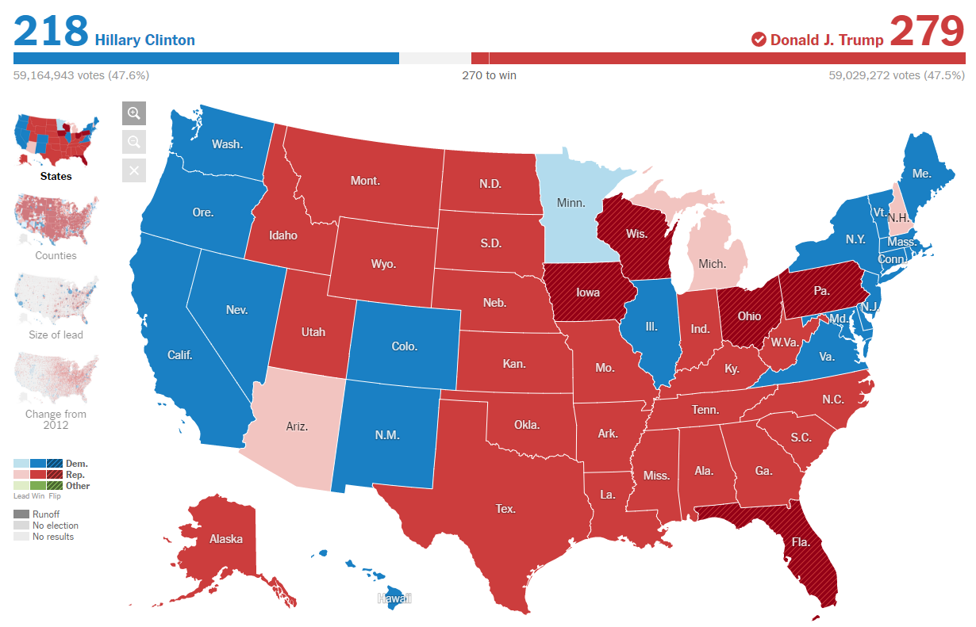
Electoral College

Slide 28
Electoral College
Electors are people chosen by the political parties at their State party conventions or by a vote of the party's central committee in each State.
They may be State elected officials, party leaders, or persons who have a personal or political affiliation with the Presidential candidate.

Slide 29
Summary of Election Process
Primary Elections
Political Party Conventions
General Election
Tuesday after first Monday in Nov:
Voters cast ballots for all electors representing a particular party in each state.

Slide 30
Election Process
• Electors Vote
Monday after second Wednesday in Dec:
Electors of party winning popular vote in each state cast ballots for President and Vice President in their state capitols.

Slide 31
Election Process
• Electoral Votes Are Counted
January 6:
Ballots cast by electors are counted by Congress

Slide 32
Election Process
• Inauguration Day
January 20:
Candidate receiving majority of electoral votes becomes President (at least 270/538)

Slide 33
Jean Jacques Rousseau Social Contract, 1762
“I was born a citizen of a free state and a member of its sovereign body, and however weak may be the influence of my voice in public affairs, my right to vote on them suffices to impose on me the duty of studying them.”

Slide 34
Voter Registration
Citizen of the U.S.
Resident of the state in which you are voting
18 years at the time of the election
Registered to vote
Selecting a political party

