Slide 1
The Constitution Convention

Slide 2
Articles of Confederation
The first Constitution of the United States.
It was weak because it lacked provisions for executive and judicial powers.
It reflected the Americans‘ fear of a powerful national government.
As a result, it created a government that had no power to tax, regulate commerce (trade), establish one national currency.

Slide 3
Articles of Confederation
The Articles gave individual states more power than the national government had.
As a result, conflicts between the states threatened the existence of the nation.

Slide 4
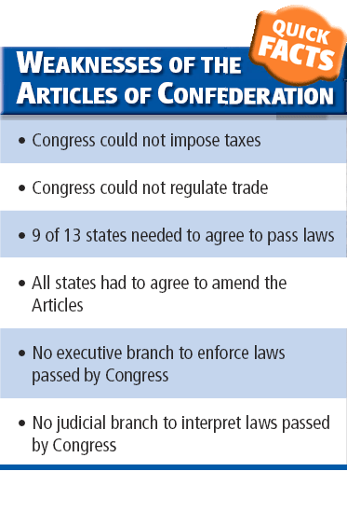

Slide 5
The Constitutional Convention
When: 1787
Where: Philadelphia’s Independence Hall
Leader Chosen: George Washington
Leaders Duties:
Call on Speakers
Maintain order and efficiency in meetings
Create committees

Slide 6
Constitutional Convention (cont.)
Purpose:
To address the weaknesses of the Articles of Confederation
Number in attendance: 55
George Washington
Ben Franklin
James Madison
As well as well-educated lawyers
Merchants
College Presidents
Physicians
Generals
Governors
And planters with considerable political experience

Slide 7
Constitutional Convention (cont.)
Who Wasn’t Attending?
Convention Rules:
Thomas Jefferson
John Adams
Rhode Island did not attend because they opposed a strong central government and there were no women, African Americans, or Native Americans because they were not considered a part of the political process
Quorum required before any meetings could be held
Each state gets one vote
Majority Rule
All members had to agree to keeping everything secret
No public allowed

Slide 8
Constitutional Convention Outcome:
The delegates all agreed that changing the Articles of Confederation were not enough so they discarded it completely and decided to write a new constitution instead.

Slide 9
Creating and Ratifying the Constitution
Virginia Plan
New Jersey
Created by: William Paterson
Government Structure:
Unicameral legislature with all states getting one vote each (equal representation).
Benefited: States with small populations
Created by: James Madison
Government Structure:
Bicameral Legislature with both based on population
Benefited: States with Large populations

Slide 10
Great Compromise:
Government Structure: AKA
Connecticut Compromise
Proposed that Congress be made up of two houses – a Senate and a House of Representatives. Each state would have equal representation in the Senate (which would please the small states.) In the House, representation would be based on population (which would please the big states.)

Slide 11
3/5 Compromise:
Problem: How to count slaves for the purpose of representation.
North’s Argument:
Had few slaves and said that slaves should not be counted since they can’t vote
South’s Argument:
Wanted to increase their voting strength in the House of Representatives
Solution: Every five enslaved persons would count as three free persons.

Slide 12
Approving the Constitution
Federalists
Anti-Federalists
Supporters of the new Constitution and the stronger national government it would create
Promoted ideas such as separation of powers and checks and balances as ways to limit the abuse of power in the new government.
Wrote a series of essays that were published in New York newspapers in order to promote the new government to the public.
Against the new Constitution and criticized it for giving more power to the central government.
Feared that the constitution would not provide individuals protection from a powerful government, which led them to ask for a Bill of Rights expressly listing citizens rights.

Slide 13
Approving the Constitution:
Bill of Rights
Federalist Papers – Series of Essays
First 10 Amendments
Amendments of the Constitution which were designed to protect
The freedom of expression
Rights of property
Rights of persons accused of a crime
No rights are absolute
All are subject to reasonable regulation through law
Written in support of the Constitution and show the framers original intents for the U.S. government
Authors:
James Madison
John Jay
Alexander Hamilton

Slide 14
Approving the Constitution
Federalist 10 and 51
Constitution Ratified
Federalist 10:
Madison argues for a federal form of government over a pure democracy.
He also discusses the “mischief of factions,” which, he believes are sown in the “nature of man.” These “Factions” refer to interest groups
Federalist 51:
Discusses Madison’s belief that a major role of the Constitution is to protect minorities from “the tyranny of the majority.”
Federalists finally agreed to include a Bill of Rights in the Constitution if it was approved.
Nine states were needed to approve the Constitution and all thirteen had ratified it by 1790.

